Slide 1
AI Tools for Research and learning and Content Creation
(أدوات الذكاء الاصطناعي للبحث والتعلم وإنشاء المحتوى)

Slide 2
outline
Your Academic Writing Assistant (مساعدك في الكتابة الأكاديمية)
Organize and Synthesize Your Research (تنظيم وتلخيص أبحاثك)
AI-Powered Presentations in Minutes (العروض التقديمية المدعومة بالذكاء الاصطناعي في دقائق)
Collaborative Coding Environment (بيئة ترميز تعاونية)
Prototype with Gemini (إنشاء نموذج أولي مع Gemini)
Advanced Search for Academia (بحث متقدم للأوساط الأكاديمية)
Uncover Audience Questions (كشف أسئلة الجمهور)
AI-Powered Video Understanding (فهم الفيديو المدعوم بالذكاء الاصطناعي)
Automated Documentation and SOP Creation (التوثيق التلقائي وإنشاء إجراءات التشغيل القياسية)
Discover and Manage AI Prompts (اكتشاف وإدارة البرومبتات الخاصة بالذكاء الاصطناعي)

Slide 3

Manus.ai: Your Academic Writing Assistant
Manus.ai is an intelligent writing tool designed to assist with academic papers, essays, and research reports. It helps structure arguments, refine language, and ensure proper citation.
manus.ai
How to use:
Upload your research notes or draft.
Select your document type and desired style.
Receive suggestions for structure, grammar, and vocabulary.
Incorporate feedback to enhance your writing.
Example: Automatically generate a bibliography in APA style from your research sources.

Slide 4

NotebookLM: Organize and Synthesize Your Research
NotebookLM is a virtual research assistant that summarizes, analyzes, and helps you explore complex topics within your documents. It acts as a personalized AI tutor for your source materials.
notebooklm.google
How to use:
Upload PDFs, Google Docs, or copy-paste text.
Ask questions about your sources to get summaries.
Generate outlines or new content based on your uploaded material.
Create study guides from lecture notes and textbooks.
Example: Upload a series of historical texts and ask NotebookLM to identify common themes and contrasting viewpoints across them.

Slide 5
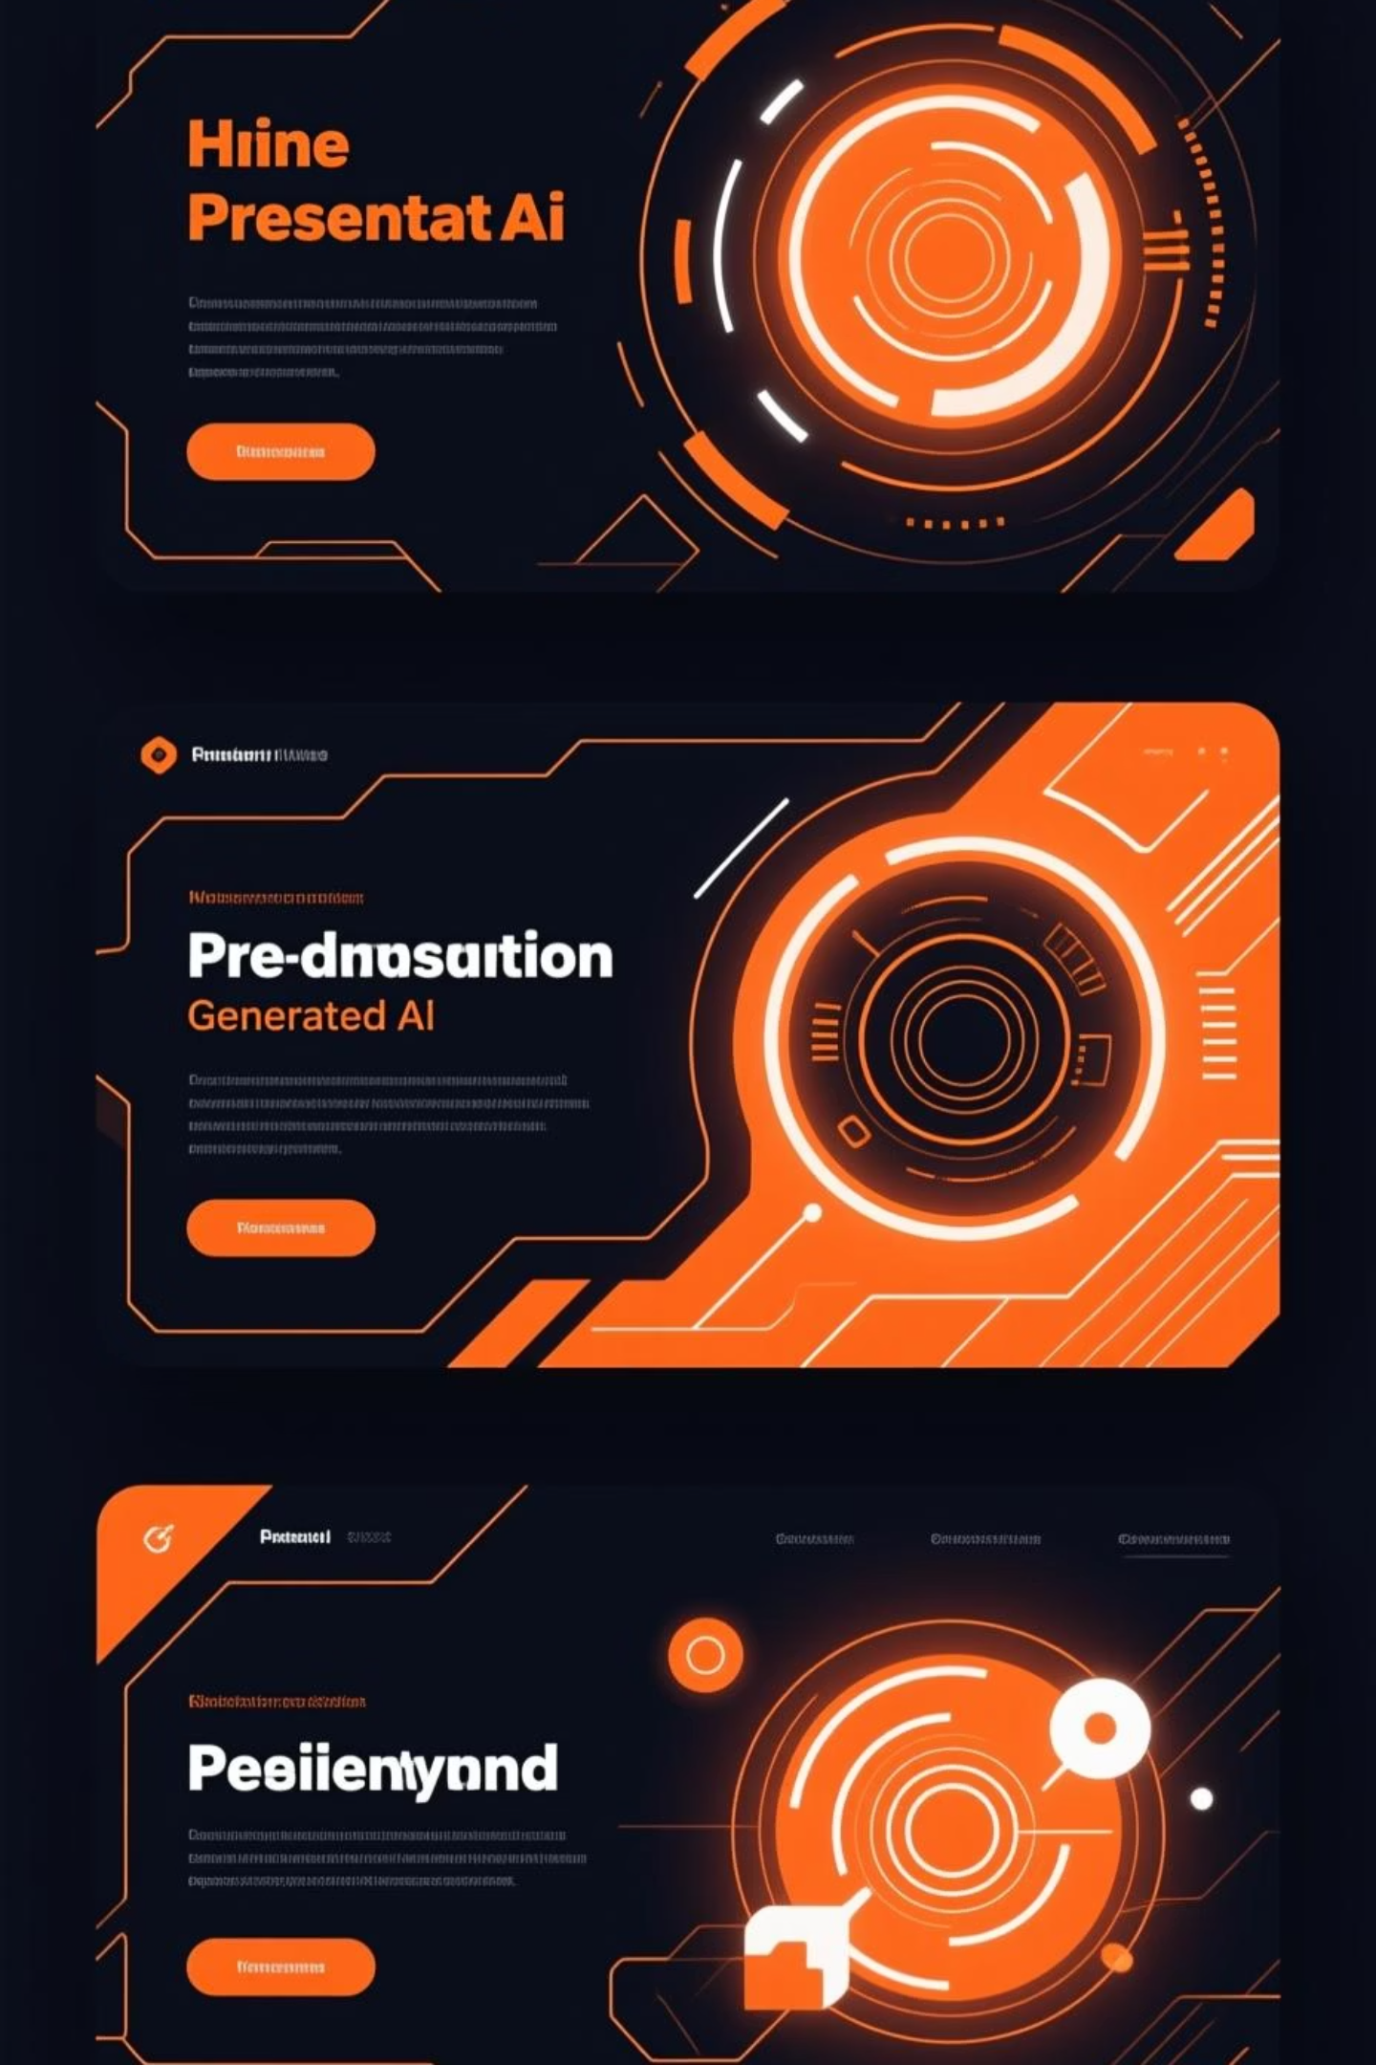
Tome: AI-Powered Presentations in Minutes
Dynamic Storytelling
Effortless Creation
Tome leverages AI to transform your ideas into polished, engaging presentations. It’s perfect for creating compelling narratives quickly.
Input your topic or key points.
Choose a template or let AI generate one.
Add media and customize your slides.
tome.app
Share your interactive presentation.
Visual Impact
Example: Quickly generate a presentation for a class project on climate change, complete with images and concise bullet points from a brief text prompt.

Slide 6

Google Colab: Collaborative Coding Environment
Google Colaboratory (Colab) offers a free, cloud-based Jupyter notebook environment. It's ideal for machine learning, data analysis, and educational coding projects, requiring no setup.
colab.research.google.com
How to use:
Access Colab through your Google account.
Start a new notebook or upload an existing one.
Write and execute Python code directly in your browser.
Share your notebooks for collaboration.
Example: Run a data visualization script using a large dataset without needing to install Python libraries locally.

Slide 7

Google AI Studio: Prototype with Gemini
Google AI Studio is a web-based tool for quickly prototyping with Google's generative AI models, including Gemini. It simplifies the process of building AI applications.
aistudio.google.com
How to use:
Access the platform with your Google account.
Choose a model and define your prompt.
Experiment with different inputs and parameters.
Integrate your prototypes into applications.
Example: Develop a chatbot that can answer questions about specific historical events by fine-tuning a Gemini model with relevant data.

Slide 8


Google Illuminate: Advanced Search for Academia
Enhanced Discovery
Insight Generation
Google Illuminate is designed to uncover deeper insights within academic and complex datasets. It goes beyond traditional search to connect concepts and findings.
Input your research question or keywords.
Review interconnected academic papers and concepts.
illuminate.google
Visualize relationships between different studies.
Identify gaps and new directions for research.
Strategic Research
Example: Explore the evolving landscape of quantum computing by seeing how different research papers cite and build upon each other.

Slide 9
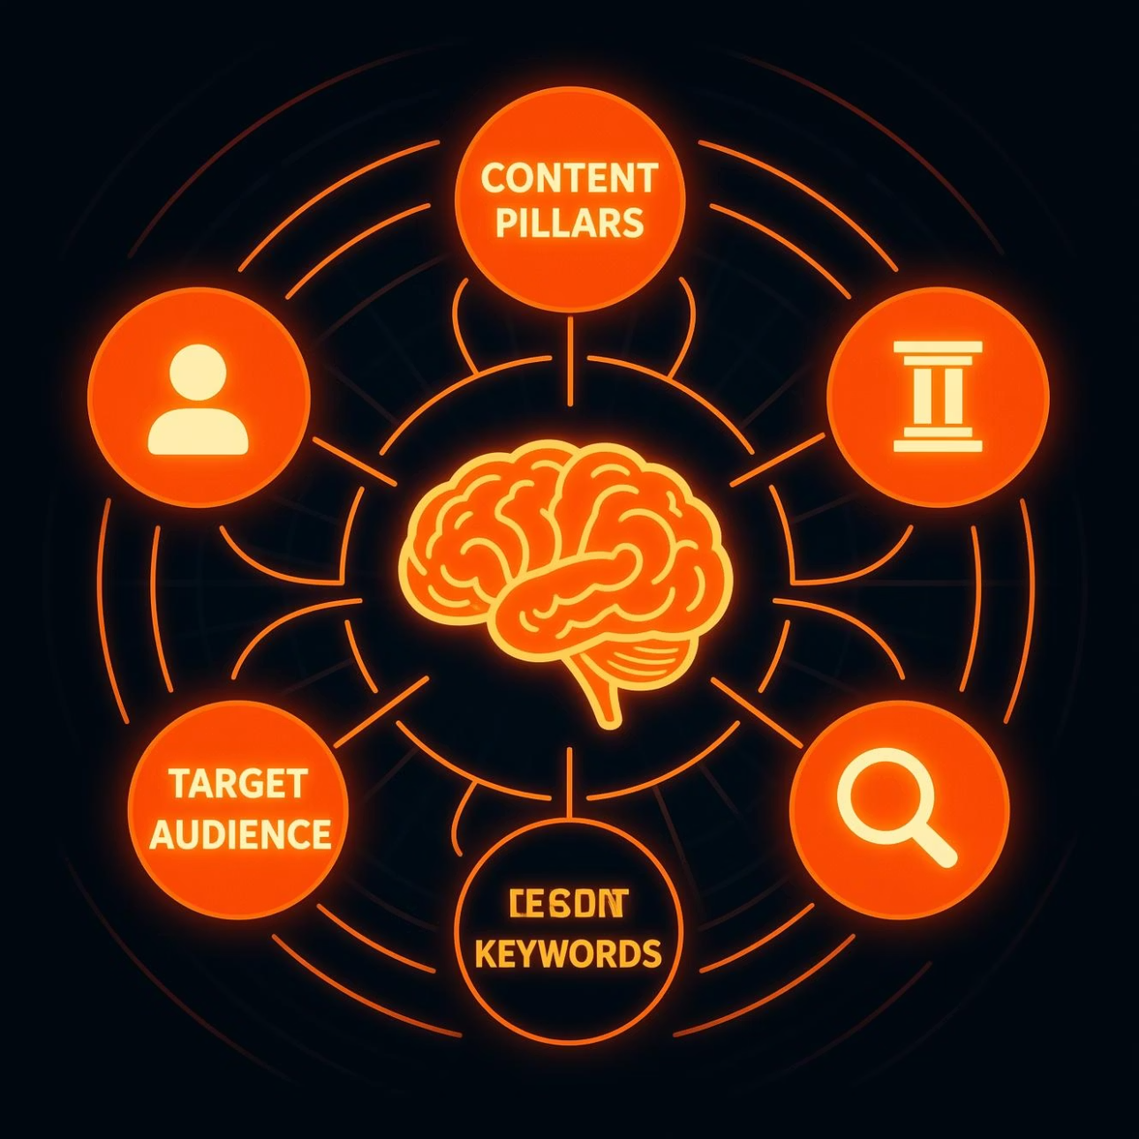
AnswerThePublic: Uncover Audience Questions
AnswerThePublic visualizes questions and phrases people are searching for around a specific topic. It's invaluable for content creators and researchers to understand public interest.
answerthepublic.com
How to use:
Enter a keyword or topic.
Visualize common questions, prepositions, and comparisons.
Identify trends and content opportunities.
Use insights to tailor your research or content.
Example: Discover all the questions people ask about "sustainable energy" to inform a blog post or research proposal.

Slide 10

Twelve Labs: AI-Powered Video Understanding
Twelve Labs offers a state-of-the-art video foundation model, Marengo 3, designed for advanced semantic search and comprehensive video analysis. It helps users unlock insights from vast video libraries with unprecedented accuracy.
twelvelabs.io
How to use:
Upload your video files or link to existing content.
Utilize semantic search to query specific actions, objects, or concepts within videos.
Analyze content for detailed metadata, sentiment, and scene breakdowns.
Generate concise summaries or highlights of long-form videos.
Example: Search an entire library of educational videos to instantly find every instance where a specific historical figure is mentioned or a particular scientific experiment is performed.

Slide 11
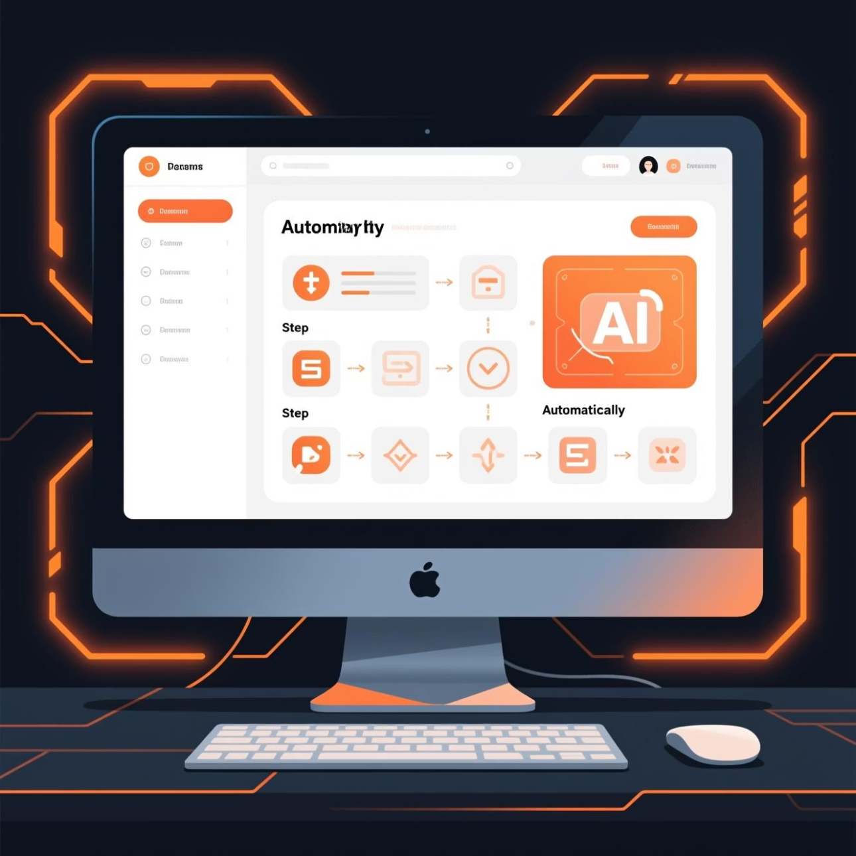
Guidemaker: Automated Documentation and SOP Creation
Guidemaker is a free Chrome extension that records your actions and uses AI to automatically generate step-by-step guides, SOPs, tutorials, and documentation.
guidemaker.com
How to use:
Install the free Chrome extension.
Press record to capture your workflow.
Let AI automatically generate your step-by-step guide.
Share with team members or embed directly.
Example: Quickly create comprehensive employee onboarding documentation by recording the process once.

Slide 12

Snack Prompt: Discover and Manage AI Prompts
Snack Prompt is an all-in-one platform for discovering, creating, and sharing AI prompts with a vibrant community of over 220,000 creators. Elevate your AI interactions with expertly crafted prompts.
snackprompt.com
How to use:
Browse a vast library of categorized AI prompts.
Discover high-quality, community-created prompts for diverse tasks.
Create and customize your own prompts using intuitive tools.
Compare outputs from different AI models to find the best fit.
Example: Find the perfect prompt for content creation or research by exploring top-rated community submissions, saving you time and improving AI output quality.

